Slide 1
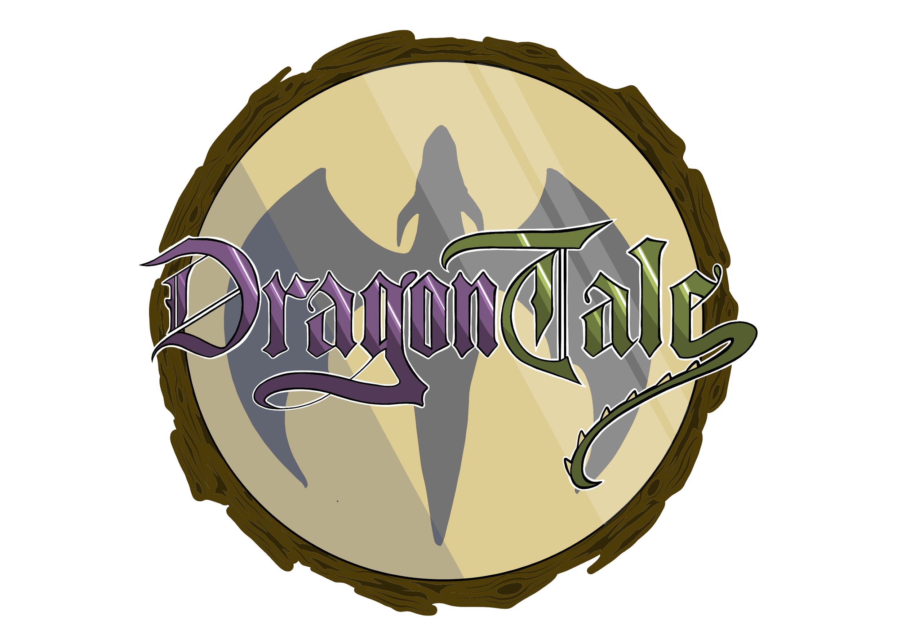
Concept
Fun
Cartoon
Medieval
Expressive
Magic

Slide 2

Color Scheme

Slide 3
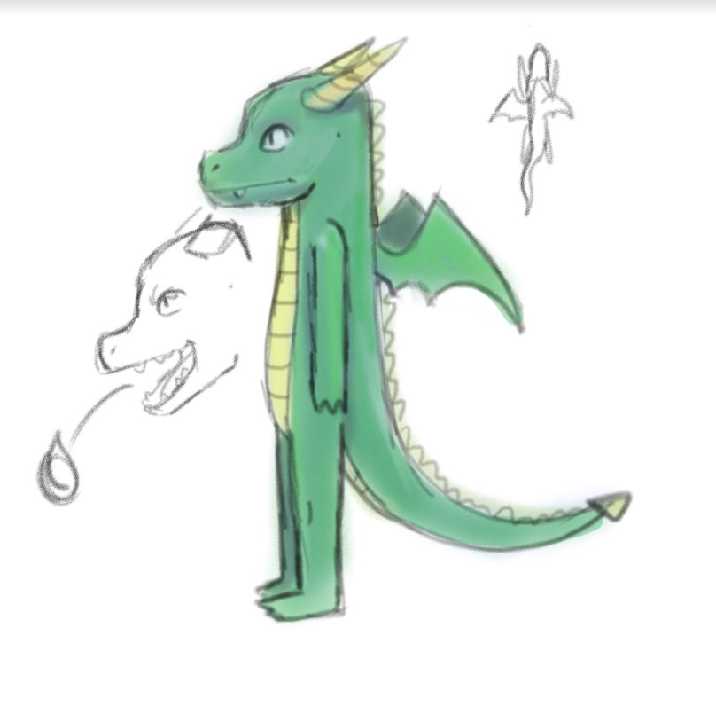
Concept Art

Slide 4
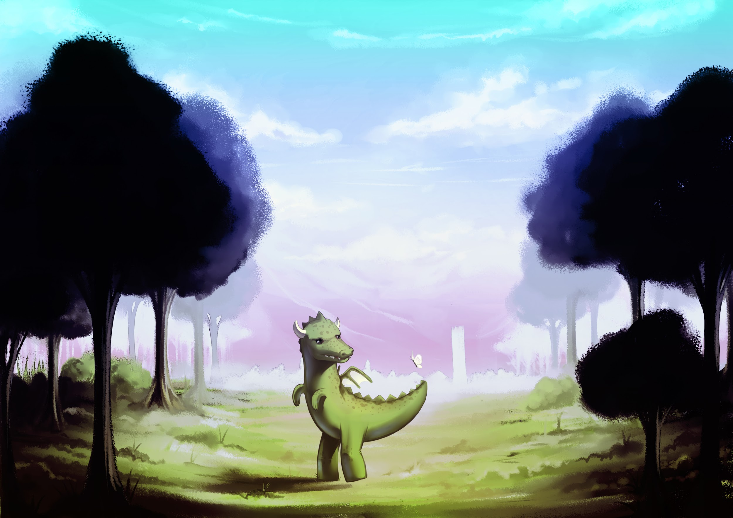
Concept Art

Slide 5
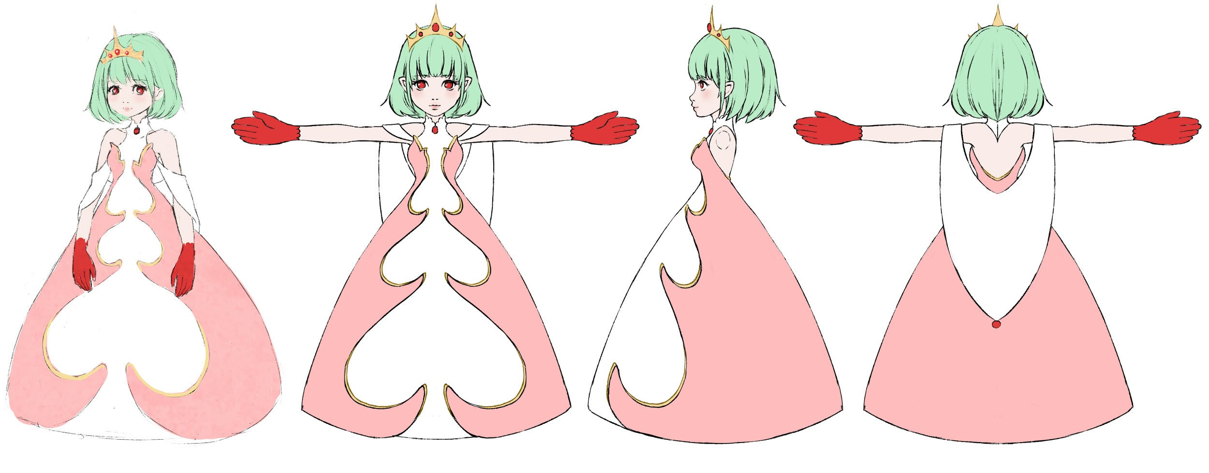
Concept Art

Slide 6
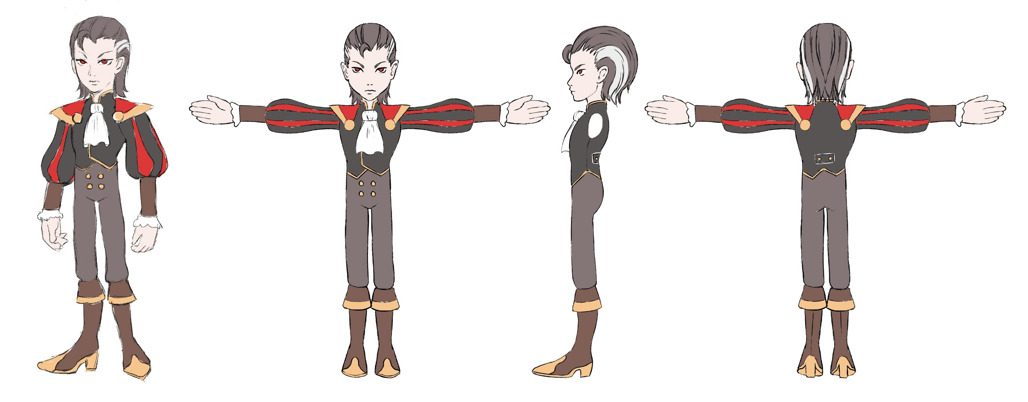
Concept Art

Slide 7
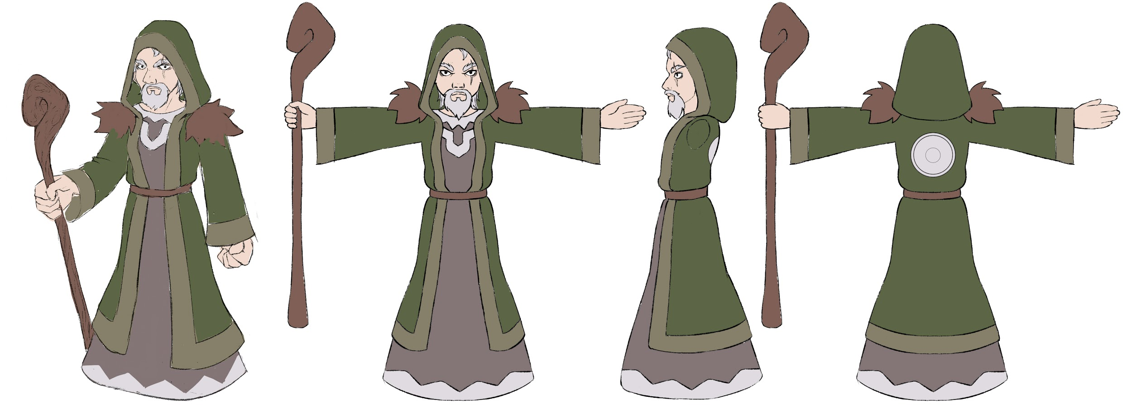
Concept Art

Slide 8
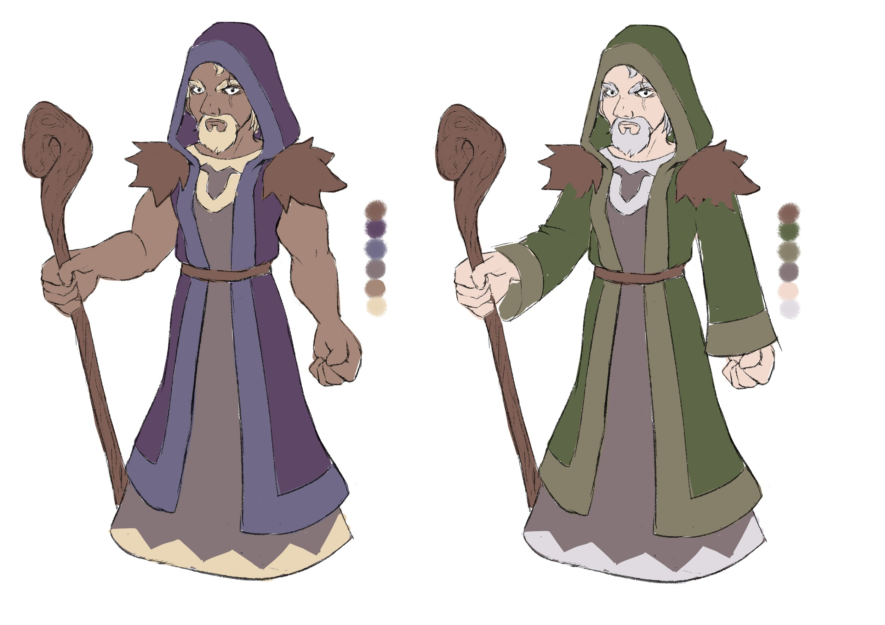
Concept Art

Slide 9
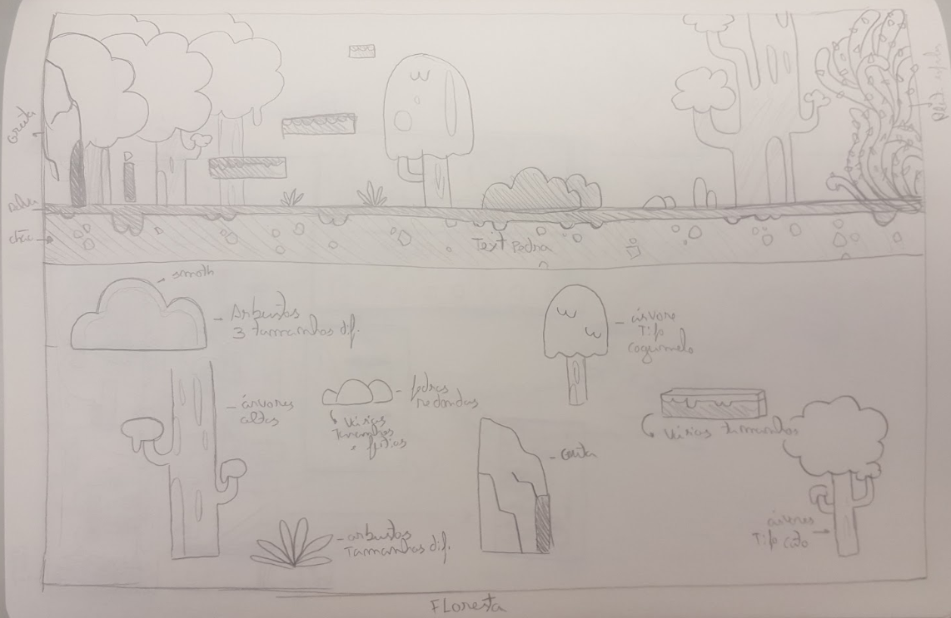
Concept Art

Slide 10
3D models

